Slide 1

Misty robot tutorial
Raymond H. Cuijpers
Associate Professor Cognitive robotics & Human-Robot interaction
Human-Technology Interaction

Slide 2
Overview
Hardware
Software
    Documentation
    Android/iOS app
    Web interface + Python interface (RESTful)
    On-robot programming
      Javascript
      C#

Slide 3
Hardware

Slide 4
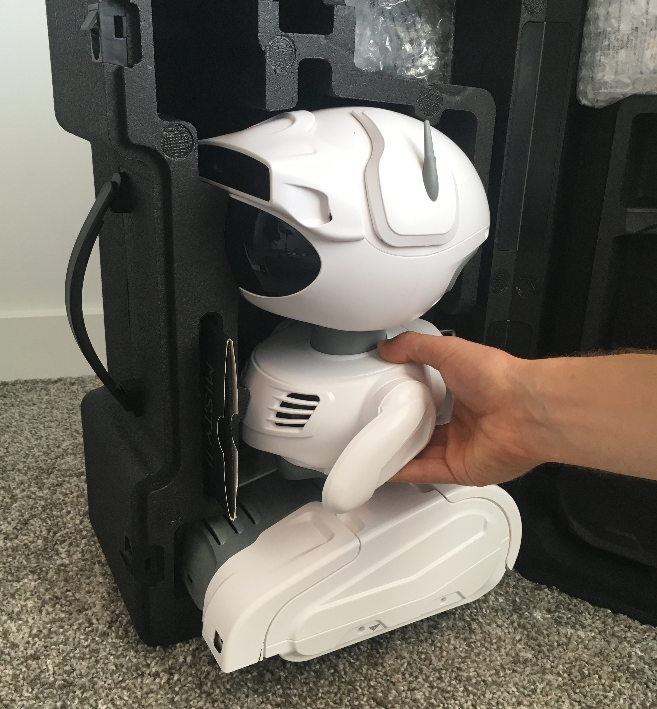
Documentation
Documentation can be found at:
https://docs.mistyrobotics.com
Please read “Misty II Overview” first.
To take Misty out of the suitcase:
Do not pull on the arms
Do not use force
To put Misty in the suitcase:
Make sure the arms are slightly inclined
as shown in the picture

Slide 5
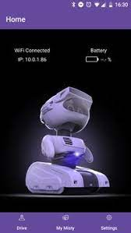
The Misty app
Needed to set-up the wifi connection of the robot
Useful for identifying IP address of the robot and other
status information
Provides tele-operation tool
Note: you do not need this with our pre-configured router,
IP address is:
192.168.0.151 for Misty 1
192.168.0.152 for Misty 2

Slide 6
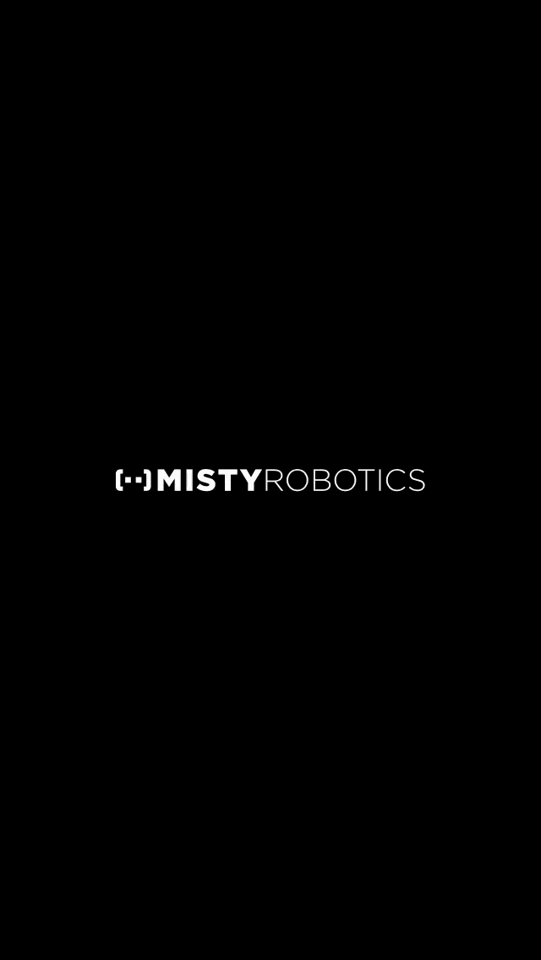
The Misty app - set-up wifi connection
App is no longer available in play/app store ☹; use USB-UTP adapter to connect directly with the robot
Power up your Misty robot and wait for her eyes to appear fully open.
Turn on Bluetooth on your phone/tablet and make sure your device is connected to your preferred Wi-Fi network.
Launch the Misty App.
  with the Misty App open on your device.
    Select your Misty from the list.
    Note: you may need Misty's serial number by
    checking the label on the bottom of your robot.
    Select your network from the list, and
    follow the prompt to enter your password.

Slide 7
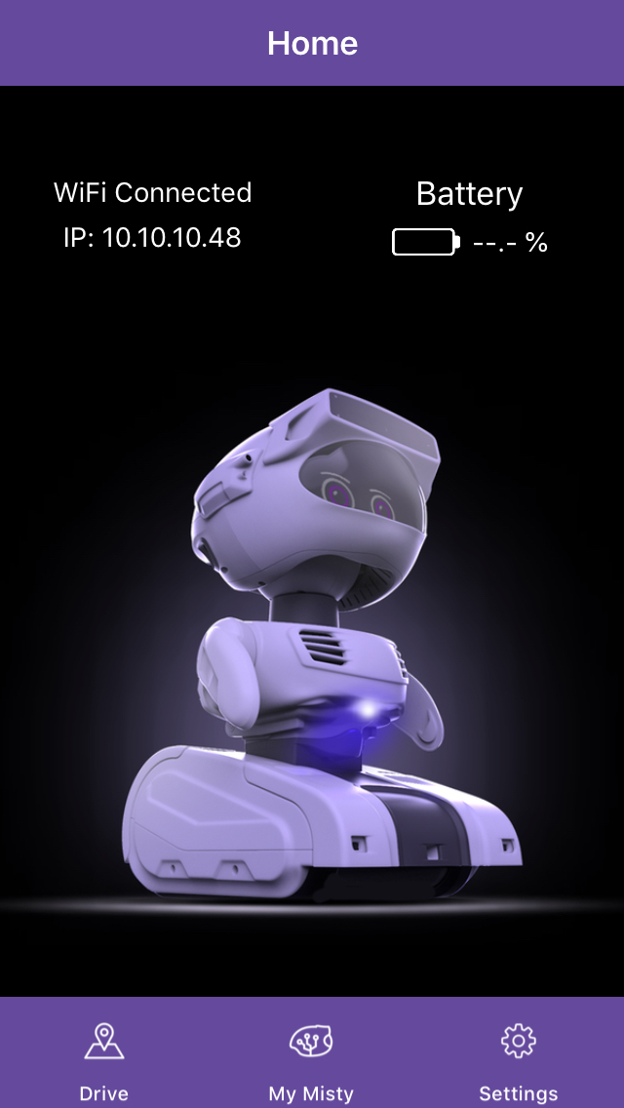
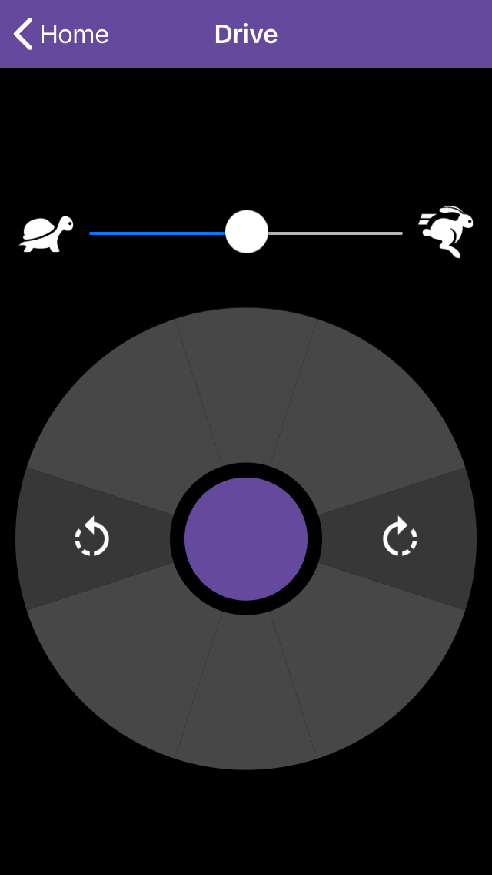
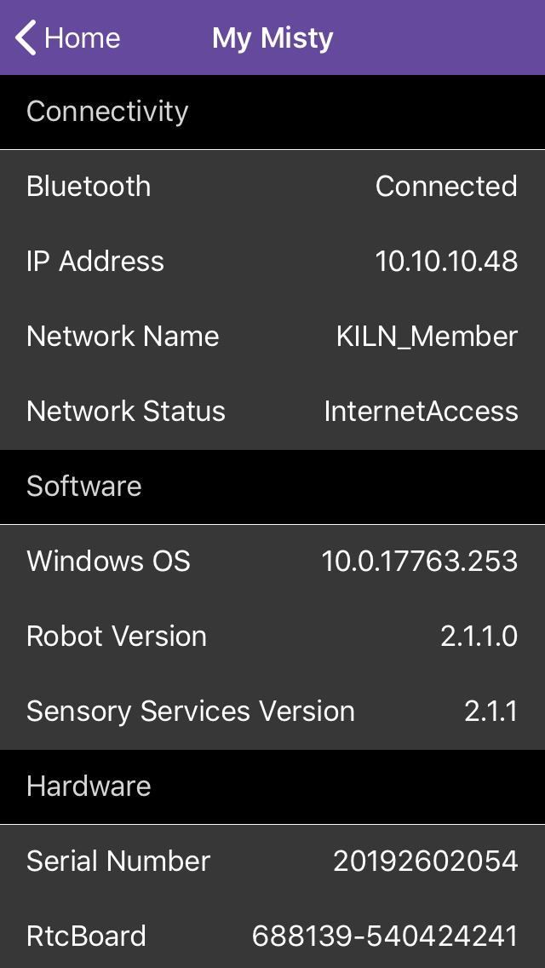
The Misty app – status info & teleoperation
Using the settings menu and the home screen you can find the robot’s IP address and the state of the battery (among others)
Using the drive menu, you can:
    move forward and backward
    Turn left/right
    change speed

Slide 8
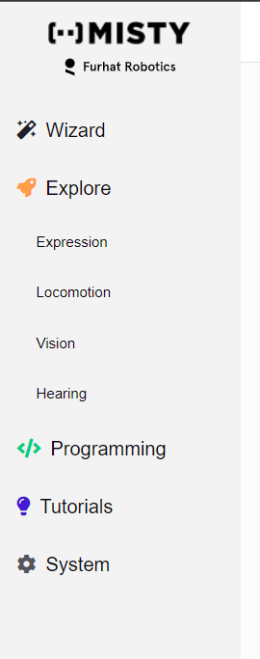
Web Interface
Open the web browser and go to Misty’s ip-address, usually 192.168.0.151 or 152
Enter your robot's IP address in the upper-right hand corner of the page and click the Connect button
Wizard – Simple web interface to operate the robot
Explore – Advanced web interface to interact with the robot
Programming – Access to Blockly and Local Python version on the robot
Tutorials – Please do all three of them!
System – not needed

Slide 9
Web Interface
For wizard-of-Oz style of experiments:
    Choose Explore from the left menu

Slide 10
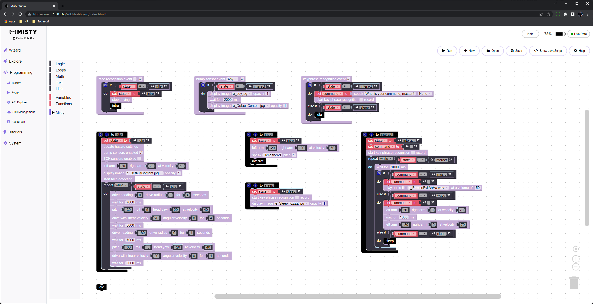
Web Interface
For Blockly programming
    Choose Programming from the left menu and choose Blockly
    Tutorials/lessons are here https://lessons.mistyrobotics.com/blockly/blockly-lessons
    You can download your local copy here: https://github.com/MistyCommunity/Blockly

Slide 11
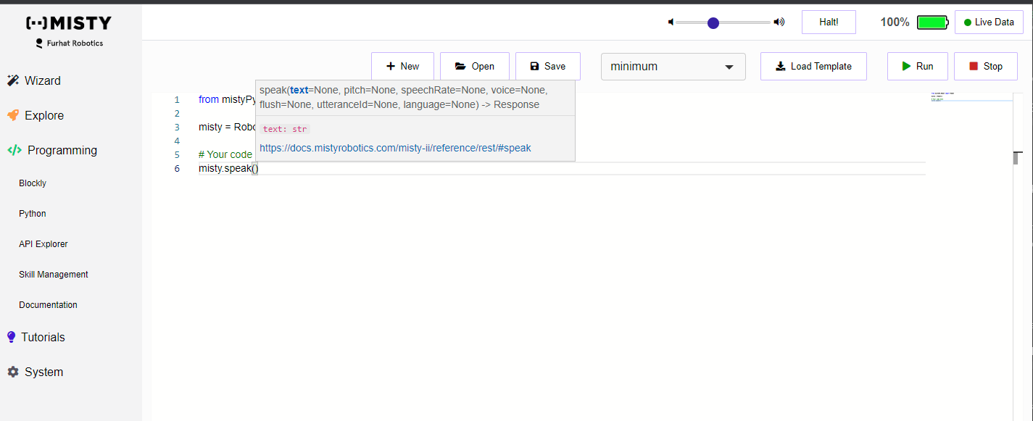
Web Interface
For Python programming using the web interface
    Choose Programming from the left menu and choose Python
    Tutorials/lessons are here https://lessons.mistyrobotics.com/python/python-lessons
    Works great for autonomous behaviours, but is limited to pre-installed python of the robot

Slide 12
Web API
Writing a robot application with Misty’s Web API typically involves two things:
    sending requests to Misty's HTTP API endpoints
    getting live data from Misty's sensors and other event types via WebSocket connections
There are different ways to send HTTP requests - for example, by writing HTTP client code, or by using the API Explorer or a REST client tool on a laptop connected to the same network as Misty
    See https://docs.mistyrobotics.com/misty-ii/web-api/overview/ for an overview
    See https://docs.mistyrobotics.com/misty-ii/web-api/api-reference/ for the API reference guide

Slide 13
Python API
To access the misty robot from python you need to install Misty-SDK for Python version 3.8 or higher. It is best to create a separate virtual environment (see e.g. https://packaging.python.org/en/latest/guides/installing-using-pip-and-virtual-environments/ ).
Open the command shell for your Python 3 distribution and install mistyPy:
pip install git+https://github.com/MistyCommunity/Python-SDK.git
Do not use “pip install mistyPy”, as it is outdated (naming convention changed)
Details on how to use this package can be found here: https://github.com/MistyCommunity/Python-SDK

Slide 14
Python API
As for the nao robot you should install other useful libraries as needed:
pip install numpy scipy matplotlib
pip install opencv-python
See https://github.com/MistyCommunity/Python-SDK for details and examples.
Great if you want to use OpenCV or Mediapipe for advanced image processing
    Python 3.10 recommended
    https://ai.google.dev/edge/mediapipe/solutions/setup_python

Slide 15
Skill programming
It is also possible to program the robot directly using javascript or C#
These so-called skills run on the robot and are needed for real-time interaction. For most purposes this can also be done using the Python API except that the robot needs to be connected to wifi
See documentation for details
See https://github.com/MistyCommunity/Documentation for examples
It is also possible to access skills from a Python using a remote computer using the requests, json and websocket packages directly. You can send and receive http requests using the REST interface of the WEB API. However, this is already implemented in the Misty-SDK for Python, so it is better to use that instead.

